Slide 1
„The European Union needs you”

Slide 2
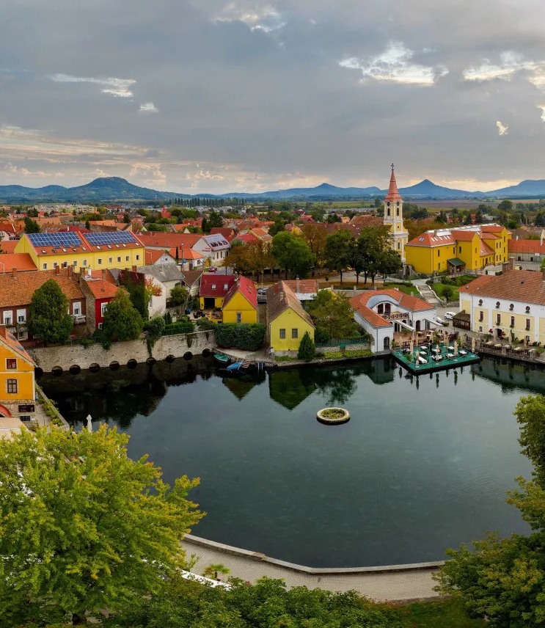
Tapolca - A hidden gem in Hungary
Located in the western part of the country
Near Lake Balaton
Also part of Veszprém the capital of culture
EU funding - infrastructure tourism, enviroment

Slide 3
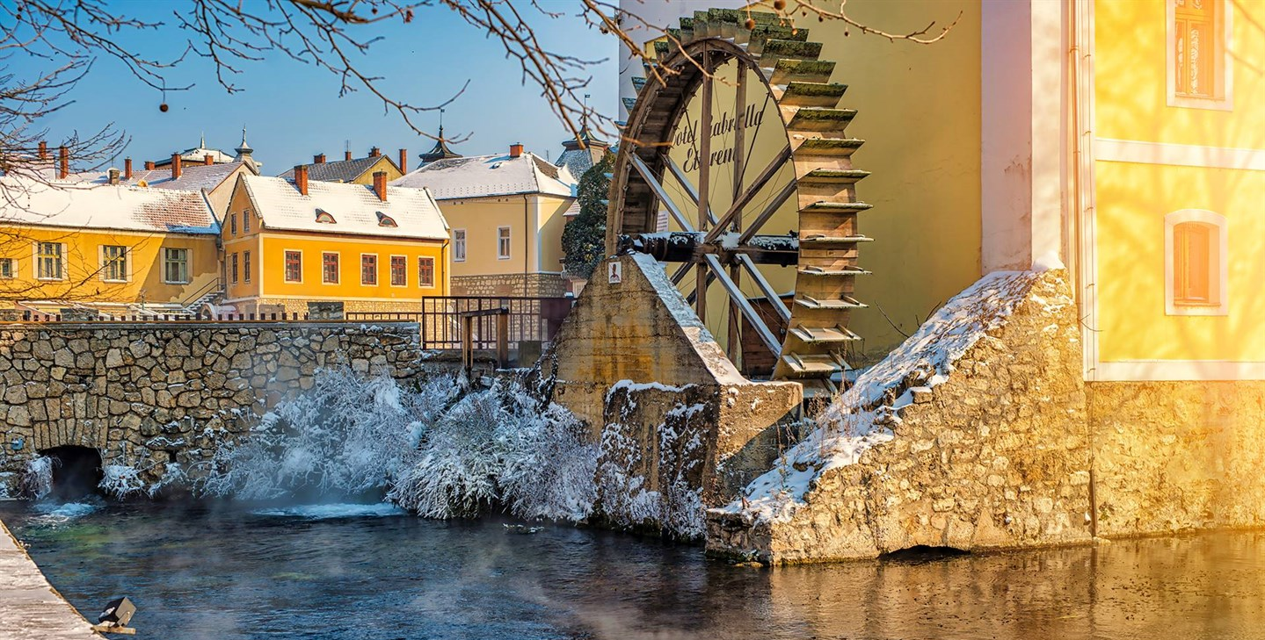
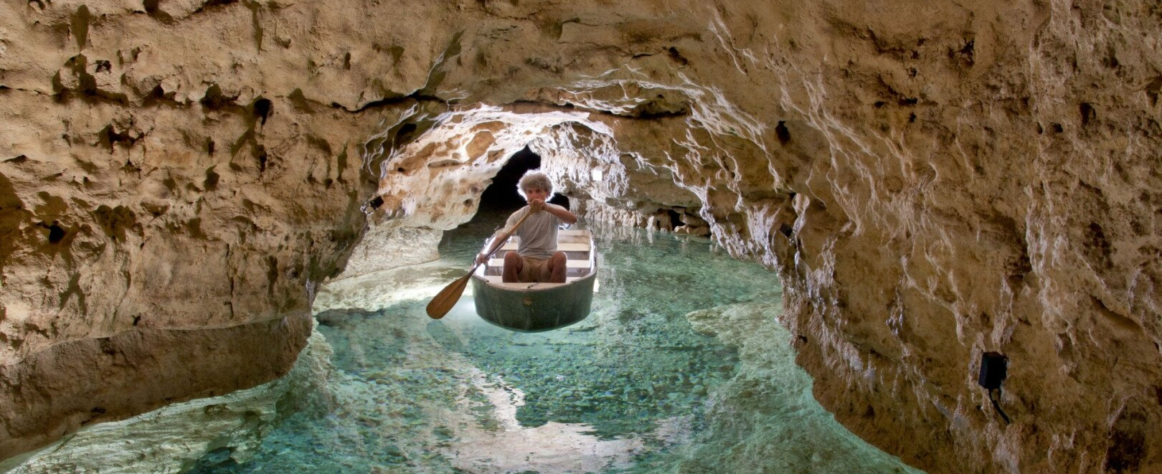
Main Attractions
Lake Cave: Explore the underground water-filled caves by boat
Mill Pond: A peaceful area in the town center, surrounded by historic buildings
Church Hill: An elevated site with a historic church and panoramic views

Slide 4
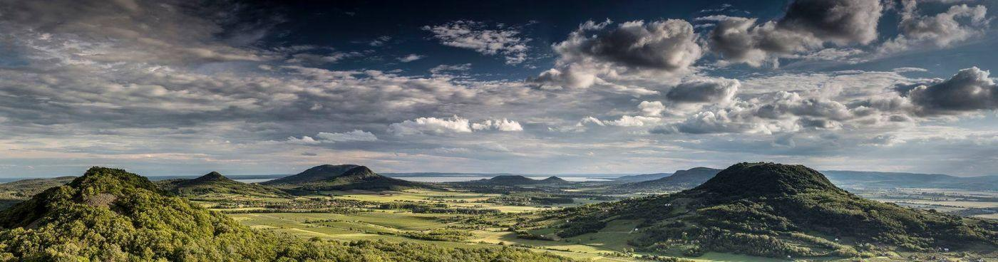
Natural Beauty & Surroundings
Close to volcanic hills and nature reserves
Perfect for hiking, boating, and exploring Hungary's countryside
A great destination for both nature lovers and history enthusiasts

Slide 5


The European Union and Hungary
From May 1, 2004.
Schengen area: December 21, 2007.
  Fast travel between the joined countries
  Lots of opportunities (study, work, family life, vacations, etc.)

Slide 6

Advantages of EU membership
Easier and safer travelling
Free movement of goods
Free movement of servicies
Free movement of capital
Economy development
  Workplaces
  Financial support for cultural and social events

Slide 7
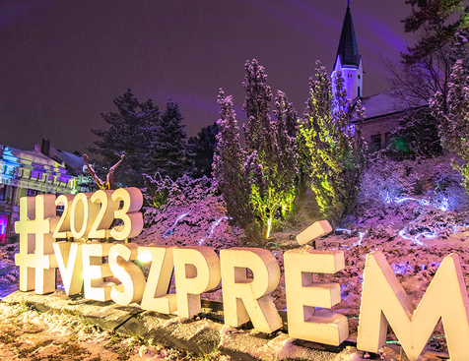

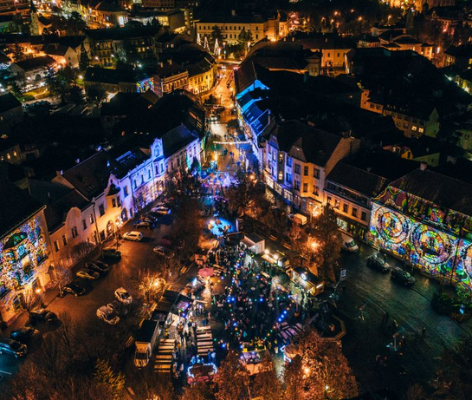
Veszprém-Balaton 2023.
Veszprém was the European Capital of Culture in 2023.
Beautiful and exciting events on 365 days of the year
Balaton and the nearby villages
Tapolca played a big role

Slide 8


Opportunities in the EU
Learning
  Language learning (bilingual schools)
  Erasmus +
    Internationality
    Social role of students and people
  European Youth Portal
    DiscoverEU

Slide 9


Opportunities in the EU
Work
  European Youth Portal
  International corporations
  Europass
    Shape your career
    Europass CV
  Living and working rights

Slide 10
Thanks for watching!

