Slide 1
Geopolitics and the EU borders
Europe Between Old and New Cleavages. Analyzing the 2024 European Elections in Order to Understand Politics in Turbulent Times
Prof. Matteo Zanellato, Università Milano Bicocca
Workshop Progetto Action. Este, 27 Settembre 2024.

Slide 2
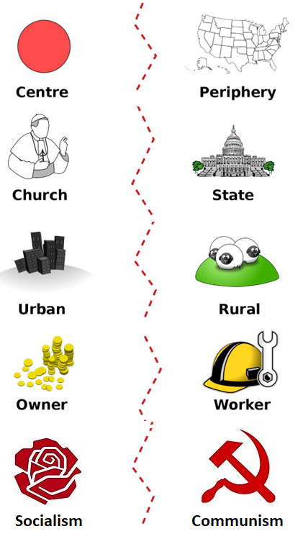
The Rokkan map
Generative process → turning point in history:
National Revolution (early 19th century; restricted electorates)
Industrial Revolution (late 19th century; suffrage extension)
Revolutions → socio-economic and cultural conflicts
Lipset and Rokkan (1967):
- Concept of ‘cleavages’ → social conflicts that became political
- Cleavages → party families
Notes:
<numero>

Slide 3
The Rokkan map
Lipset and Rokkan (1967) distinguish four main cleavages.
National Revolution induced two cleavages:
Centre-periphery cleavage
→ regionalist parties (control of the administration)
(e.g. Scottish National Party, the Swedish Party in Finland)
2) State-church cleavage
→ conservative and religious parties (language and symbolic issues)
(e.g. Christian Democratic Union, Swiss Catholic Party)
Notes:
<numero>

Slide 4
The Rokkan map
The Industrial revolution induced two further cleavages:
Rural-urban cleavage (control of the economy: conservatives vs. liberals)
→ agrarian and peasant parties
(e.g. Australian County Party)
(4) Workers-employers cleavage (control of the means of production)
→ workers and social-democratic parties
(e.g. British Labour Party).
(most important cleavage, characterizing the left-right alignment)
Notes:
<numero>

Slide 5
The Rokkan map
The Post industrial Revolution created two more recent cleavages:
(5) Materialism-post-materialism cleavage (1960s/1970s):
→ social movements, and Green-Parties
(6) The globalization cleavage
→ neo-populist protest parties
right-winged and xenophobic (e.g. Front National in France)
left-winged in Latin America
Notes:
<numero>

Slide 6
EU as a cleavage?
Phase 1: Ideological conflict between two different worldviews. Phase 2: Europe as a sleeping giant that could not be considered a cleavage: Although very relevant to the lives of citizens, EU integration was depoliticized by traditional parties and elites due to the spillover effect. EU integration was primarily a top-down process driven by elites in a context of permissive consensus, until the EU crisis.
NOW
Phase 3: Attitudes towards Europe are now expressed in national and European elections, as well as in national referendum campaigns, which escape the control of traditional parties.

Slide 7
THE CRISES THAT THE EU MUST FACE
ECONOMIC → Material foundations of the regime in the economic sphere
COVID-19 → Material foundations of the regime in public health and individual freedom
MIGRATION → Identity issues
CLIMATIC → Material foundations of the regime in the field of ecosystem protection
MISTRUST IN NATIONAL AND EUROPEAN INSTITUTIONS → Legitimacy of the political regime

Slide 8
% TRUST IN INSTITUTIONS

Slide 9
The politicization of the EU as part of an emerging cleavage
The perforation of nation-states by immigration, integration, and the outcomes of the economic crisis can signify a critical juncture in Europe's political development, creating:
winners (pro-integration) and losers (pro-demarcation) of globalization.
The politicization of the EU becomes part of a transnational cleavage, visible through the increased salience of EU issues, greater importance given to EU topics by political actors, and the growing polarization of positions on the EU

Slide 10
A transnational cleavage
Party systems are structured around certain cleavages originating from the past, and it is difficult to change their political platforms.
Political parties and party elites are reluctant to embrace change.
As a result, changes in the party system occur through the emergence of new parties that represent unrepresented values and interests. Under these conditions, the cleavage on globalization has emerged.

Slide 11
A transnational cleavage and the party system
Traditional parties did not address these issues, and voters turned to parties that positioned themselves on the new cleavage.
The TAN (Traditional, Authoritarian, Nationalist) radical parties define the framework of competition on transnational issues
GAL (Green, Alternative, Liberal) parties take diametrically opposed positions.

Slide 12
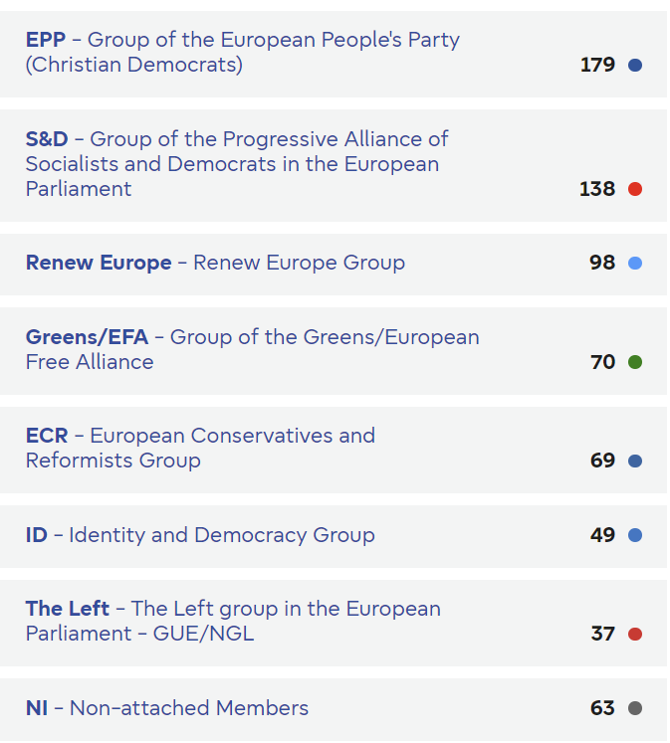
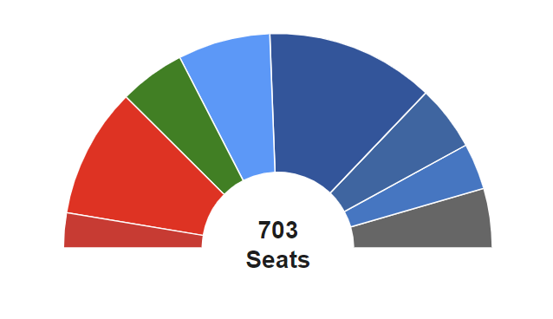
Eu elections results 2024 – the old parliament

Slide 13
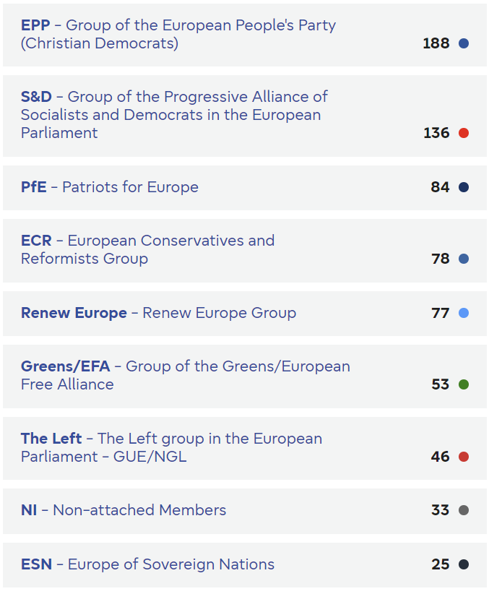
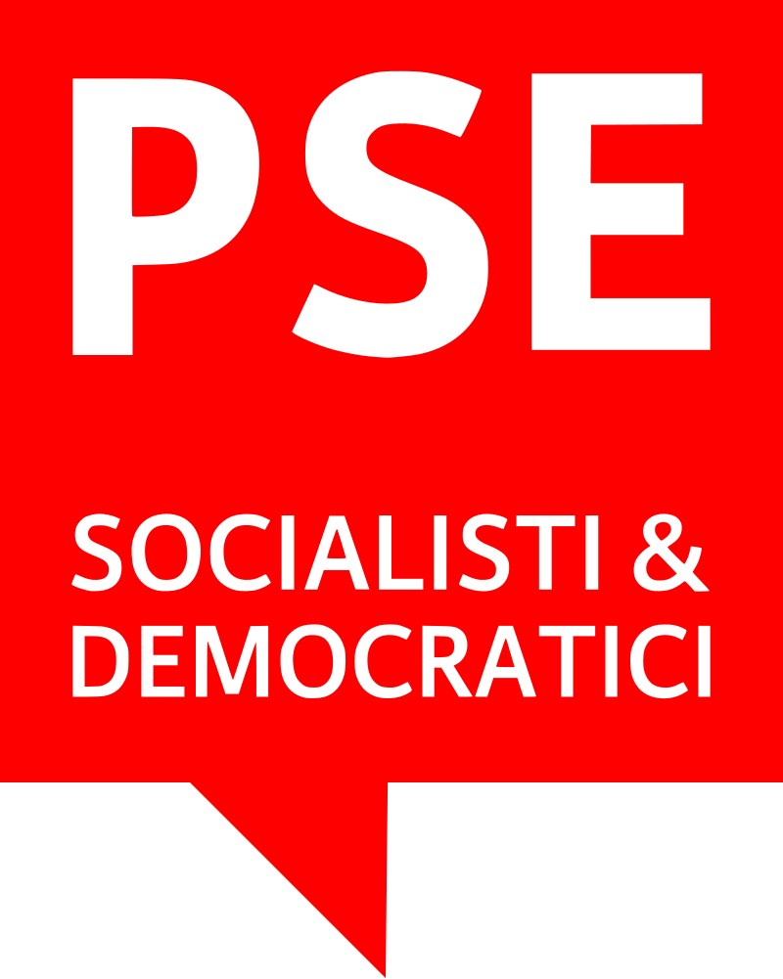
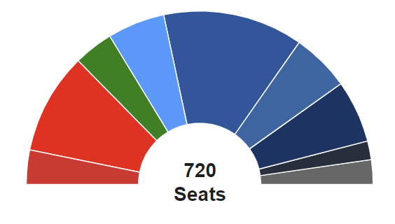
Eu elections results 2024 – the new parliament
Notes:
<numero>

Slide 14
POPULIST PARTIES IN THE EUROPEAN PARLIAMENT
Mainstream:
EPP+EPS+ALDE/RE
Populists:
ID+EFDD+OTHERS

Slide 15
Most important policies and party positions
Social protection
Economic freedom
AI for people
AI for companies
Industrial policies
Green transition
More migration
Less migration

Slide 16
Most important policies and party positions
Stand with Palestine
Stand with Israel
Neutral
With Ukraine
Against further enlargments
In favour of further enalrgement
Less political integration
More federalism

Slide 17
Open debates
Democratic deficit
EU after Brexit
The migration crisis
Euro and the economic governance of the single currency
Return to power politics and challenge to the international role of the USA

