Slide 1
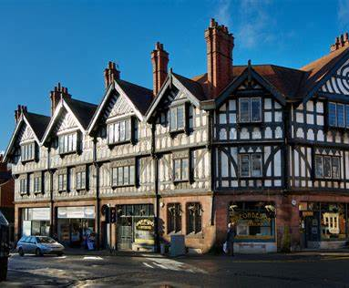
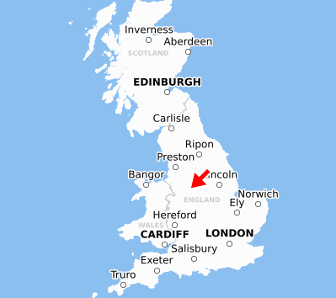
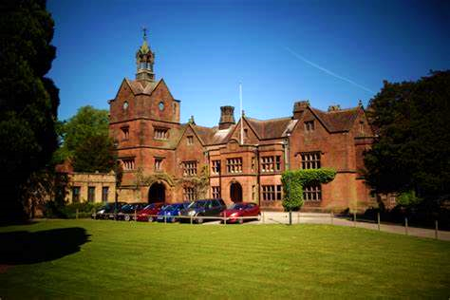
Leek – Este
EU Values

Slide 2
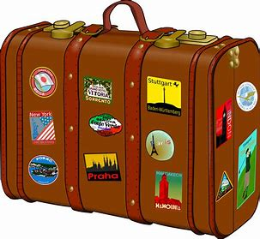
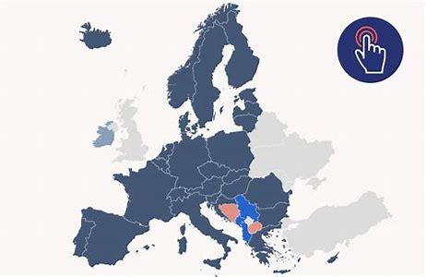
Freedom
Within the EU you are free to...
Move, work and study in the EU
Express your opinions and values
Before 2020, Erasmus allowed UK students to study abroad as well as other EU students to come to the UK. It was an opportunity to enhance diversity. Allowing students to immerse themselves in new cultures and improve language skills. Recent studies also show the scheme has enhanced students' quality of life and career prospects. Since Brexit (Britian leaving the EU), Erasmus has been replaced by the Turing Scheme. This scheme is global and has less of a focus on the EU. Additionally, there is less support finically in the Turing Scheme unless you qualify for certain bursaries. This is one example of the way young people can take advantage of the freedom the EU brings them.
EU external borders:
These are the borders where countries meet within the EU and ,importantly, they allow you to move freely within the EU. Before Brexit, travelling within the EU was much easier. Sadly, there are now more constraints such as visas and further controls when travelling between borders.
Whilst we were unable to partake in the Brexit vote since being too young, the democracy of the vote itself shows the freedom we can express our political opinions – even if the end result goes against your personal values

Slide 3
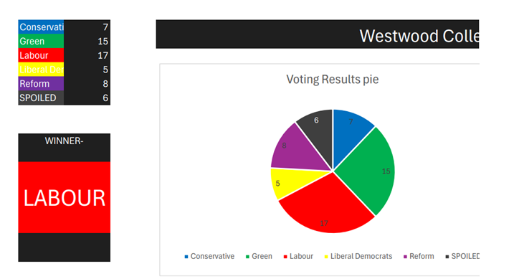
Democracy – Government by the People
Democracy in the UK: our recent General Election
On the 4th of July 2024, the UK held its most recent general election, in which any citizen above the age of 18 were able to vote for a local representative of any political party that they considered most eligible. The party who were voted for the most ‘seats’ in parliament are declared ‘victorious’ against the other parties, and their leader becomes the Prime Minister. This year, Sir Keir Starmer, leader of the Labour Party, became Prime Minister in a landslide victory against the Conservative Party, who had been the governing party since 2010.
Though democracy has its limits, and we were not able to vote ourselves (being under the age of 18), we did hold a ‘mock’ election at our college, to gage the majority political stance of our own generation. These were the results –
Not dissimilar from the actual results, Labour won; however, the Green party at a close second is a great contrast to the official results, and perhaps a suggestion as to the direction our politics may be heading, in years to come.
Not only is Democracy an important value: it is a responsibility and a privilege that each of us must not take for granted. Democracy fails where the people do not take responsibility for their ignorance, and their interest not only in themselves, but in others. For it is the younger generation, who do not yet have the right to vote, who must bear the consequences.

Slide 4
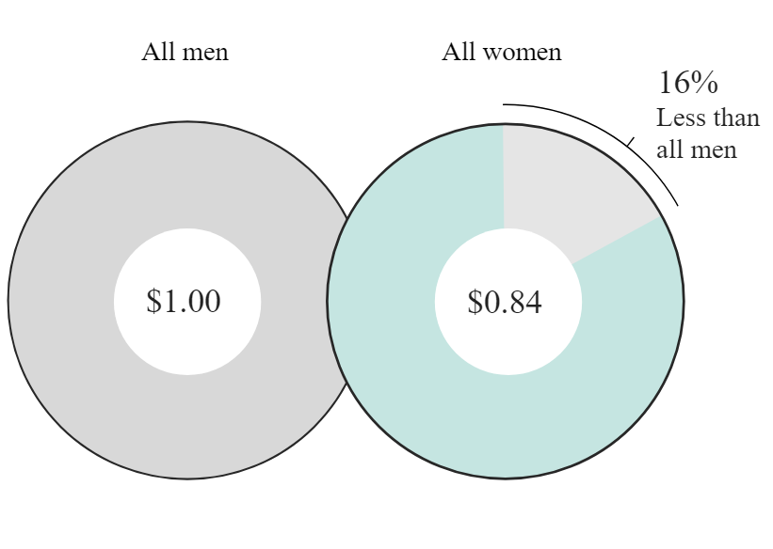
Equality and Human Rights
Equality:
The right to equal pay for women and men for equal work or work of equal value has been a founding principle of the European Union since the Treaty of Rome in 1957. However, Women in the European Union continue to earn less than men with the average gender pay gap in the EU standing at 12.7%. This means that for every €1 a man earns, a women will make only €0.84. Comparing this to the UK post BREXIT, our gender pay gap stands at around 14.7%. In other words, the typical woman working full-time would need to work from January 1, 2023, until March 12, 2024, to make what the typical man working full-time made in 2023. We think this shows a way that leaving the EU has negatively impacted the UK.
Human rights:
Even after leaving the EU, the UK’s human rights values have remained the same, the only change being the laws around them being rewritten. Like the EU, these values include the right to life, liberty, fair trials, and freedom of speech and assembly. The EU also has separate legislation for the rights of a child - United Nations Convention on the Rights of the Child (UNCRC) confirms this and further strengthens the protection of children's rights.
EU human rights values :
Human dignity - Freedom of thought
Right to life - Equality
Security - Education
Liberty -Respect
Fair trial - Freedom of expression

Slide 5
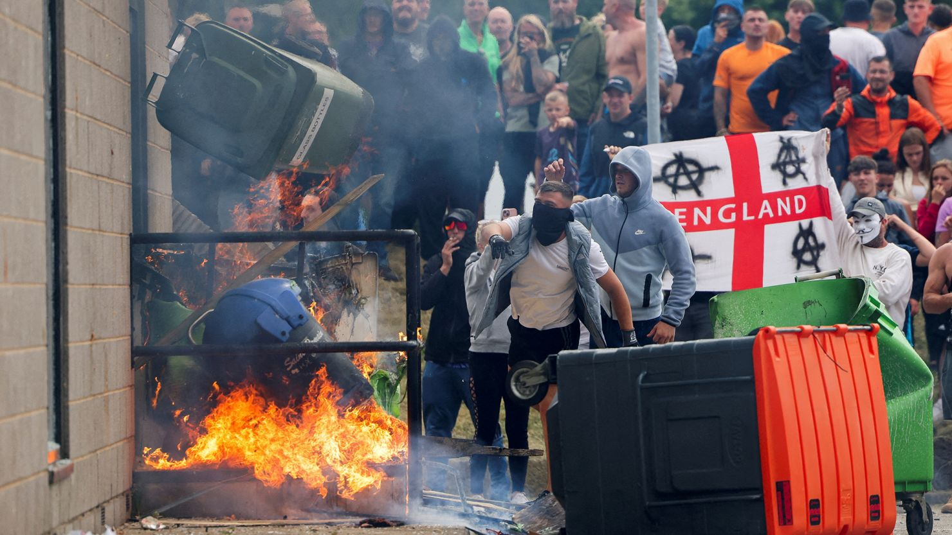
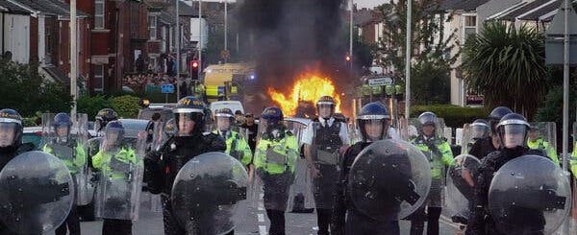
Recent Riots – Going Against EU Values
This summer, following a mass stabbing in Southport: a group of far-right, anti-immigrant protests have been taking place across all areas of the UK.
The riots took place between 30th July and 7th August 2024 and saw over 130 police officers sent into critical care, as well as 7 police dogs and 2 police horses. Our police restrained from demonstrating the same aggression with only 1 protestor harmed out of 1034 who were convicted.
Riots even took place in Hanley, which is about 20 minutes outside of our hometown of Leek. With over 100 arrested, businesses had to barricade their shop fronts, and even a children's dance show had to be put on lockdown due to rioters attempting to break through the windows to 'scare the kids'.
These actions do not accurately reflect the values and morals UK citizens hold dearly and are an inaccurate representation of our nation's treatment towards refugees and immigration.

Slide 6
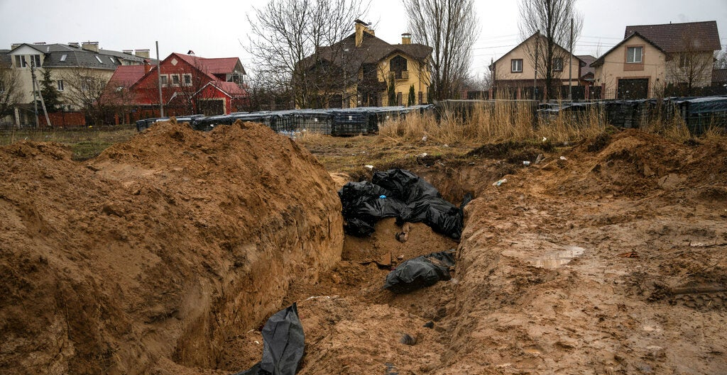
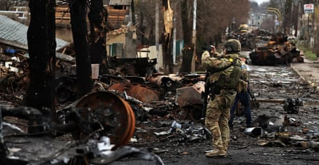
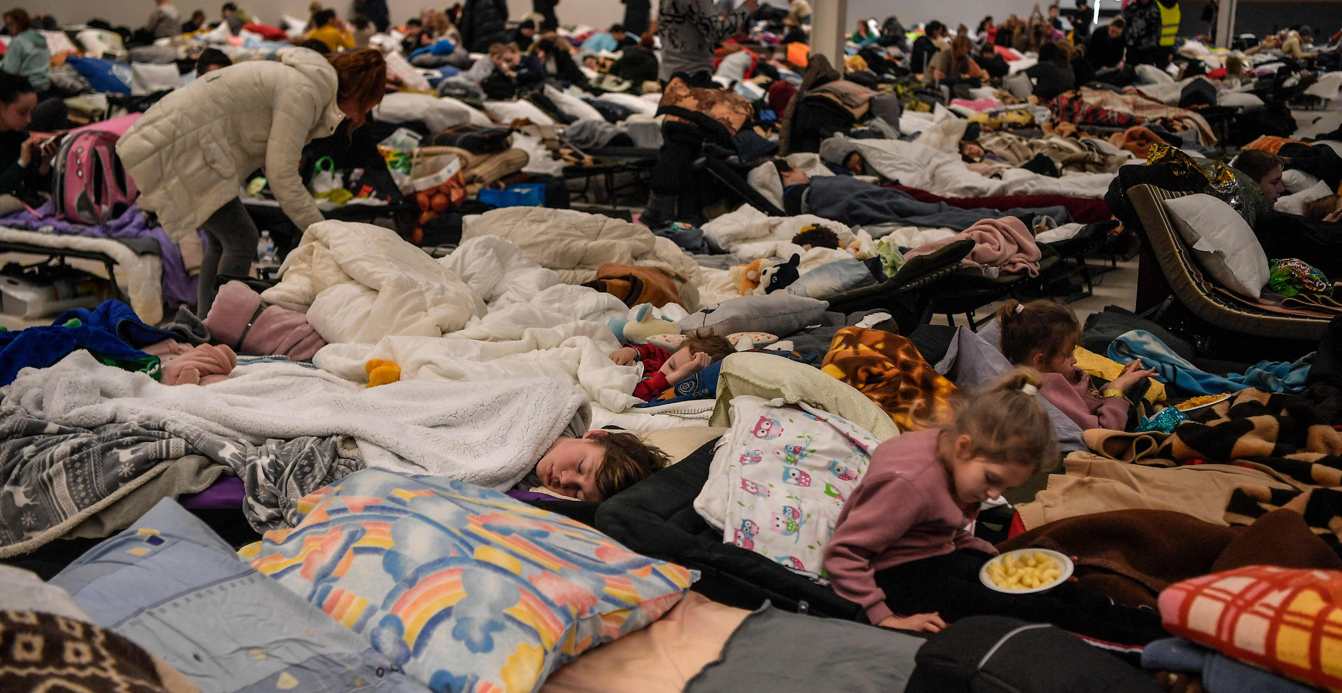
Human Dignity and Right to Life
Ukraine War
Since 2022, 6919 people have died in the Ukraine war and many Ukrainians have encountered an even worse fate. About 2.8 million Ukrainians are detained in Russia; for which reports of beatings, electric shocks, waterboarding, and mock executions are common, not to mention the countless families torn apart, many will not have homes to return to. It is horrifying that in our “civilized continent” one of Europe’s “developed nations” can stoop to such atrocities and is surely a blow to the European standard of human dignity.
Refugees and support
Despite this, the rest of the EU appears to retain its regard for human dignity accepting over 5 million refugees, chief amongst being are Germany, Poland, and Czechia with about 2 million between them. In fact, Europe's and the world's reaction to this conflict has been endearing, showing vast physical and moral support has demonstrated our continent’s integrity and regard for human dignity through perhaps Europe’s greatest challenge to unity and peace this millennium, and a motif we should hope to represent throughout it.

