Slide 1
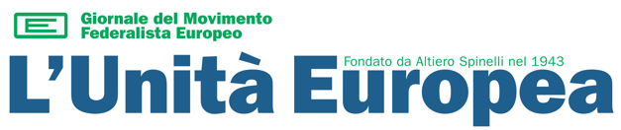
Democracy and EU values
Workshop ACTION Project
Este - September 27, 2024
Notes:
<numero>

Slide 2
Summary
1941 - 1949
From hell to a new Europe
1950 - 1954
Building European institutions
1955 - 1978
A functionalist Europe
1979 - 1989
The new European Parliament
1990 - 2009
Eastern enlargement and European Constitution project
2010 - today
A multi-faceted crisis (or the decline of Europe?)

Slide 3
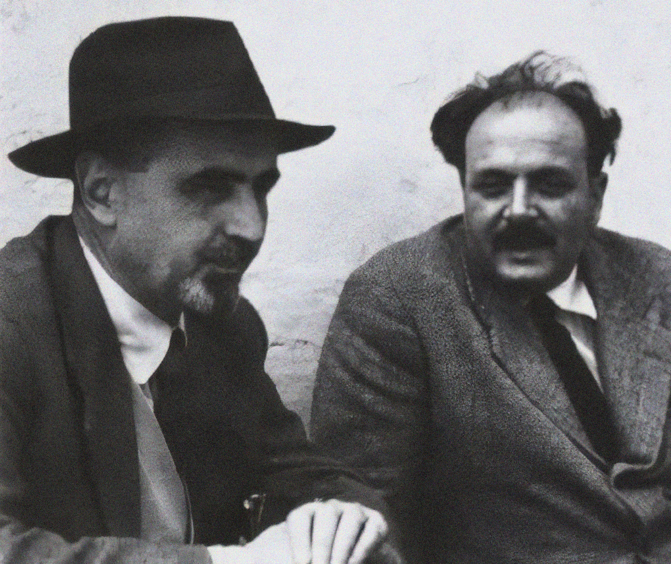
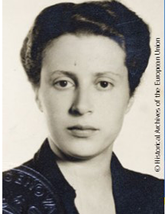
1941 – 1949: from hell to a new Europe (1/3)
«Only a problem that continues to resurface despite defeats is a truly historic problem, a problem that cannot be set aside.

Slide 4
1941 – 1949: from hell to a new Europe (2/3)
Second World War was not an accident but the historic logical consequence of the crisis of nation States
  In previous centuries, many attempts to unifying Europe with armies (from Charles V to Hitler)
  First World War marks the start of the crisis of European centrality on the world stage
  Nationalism suppresses democracy in Europe
Imperialist way of unification

Slide 5
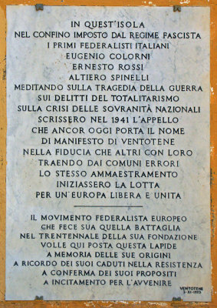
1941 – 1949: from hell to a new Europe (3/3)
  1941: While interned in Ventotene by the Fascist regime, Spinelli and Colorni write the Ventotene Manifesto
  Then, foundation of Movimento Federalista Europeo (1943) and Union of European Federalists (1946)
  The federalist struggle doesn’t succeed and independent States are formed again
Federalist way of unification

Slide 6
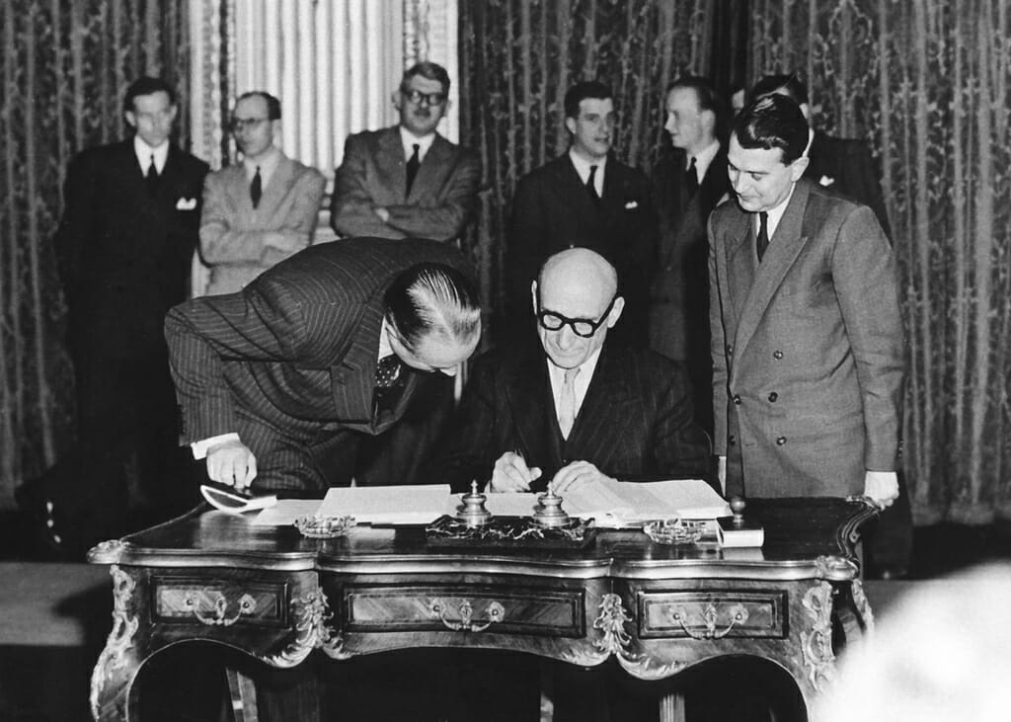
1950–1954: building European institutions (1/3)
«Cette proposition réalisera les premières assises concrètes d'une Fédération européenne indispensable à la préservation de la paix.»

Slide 7
1950–1954: building European institutions (2/3)
Against post-war difficulties, some Western European leaders decide to lay the foundation of European integration
  After WWII, Europe’s fate is imposed by the two superpowers - USA and USSR - who divide Europe along the «iron curtain»
  The fear of Stalin and the matter of German army’s reconstitution push some European leaders to establish the first European institutions, with the aim of preventing a new war within Europe
Hence, preservation of peace is the cornerstone of the European integration process

Slide 8
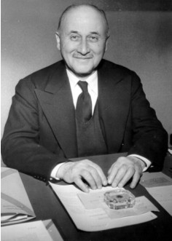
1950–1954: building European institutions (3/3)
  May 9, 1950: Schuman declaration (inspired / written by Jean Monnet)
  1951: The European Community of Steel and Coal’s entry into force
  August 30, 1954: the project of a European Defence Community and a European Political Community get refused by the French Assembly

Slide 9
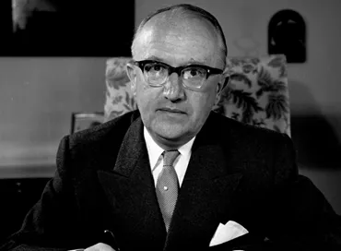
1955–1978: a functionalist Europe (1/3)
«Der unvollendete Bundesstaat»

Slide 10
1955–1978: a functionalist Europe (2/3)
The establishment of a common market stimulates intra-EEC trade and promotes a new prosperity
Functionalist way of unification
  The European Economic Community is so successful that new states want to join
  Values of democracy spread in Western Europe (see Greece, Portugal, Spain), though Europe’s fate is still in the hands of the two superpowers
  The functionalist Europe is accompanied by political campaigns in favour of the direct election of the European Parliament

Slide 11
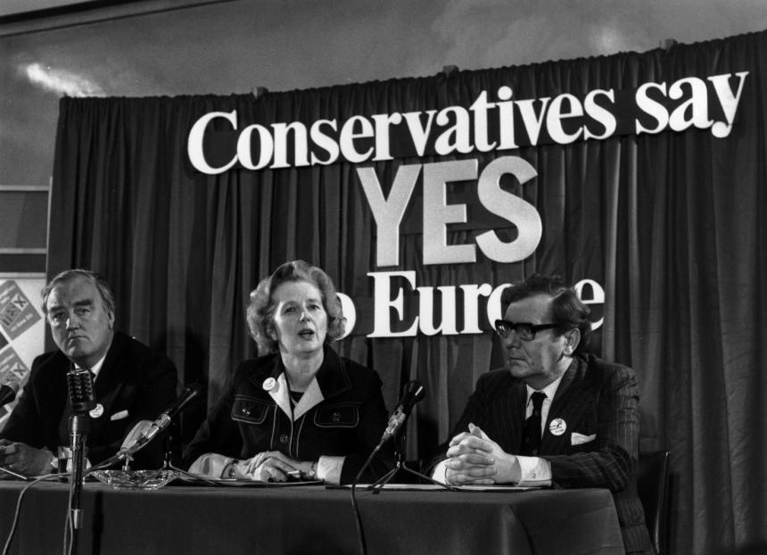
1955–1978: a functionalist Europe (3/3)
  1955: Messina conference
  1957: creation of the Euratom and the EEC
  1973: first enlargement (UK, Ireland, Denmark)
  1979: First European election

Slide 12
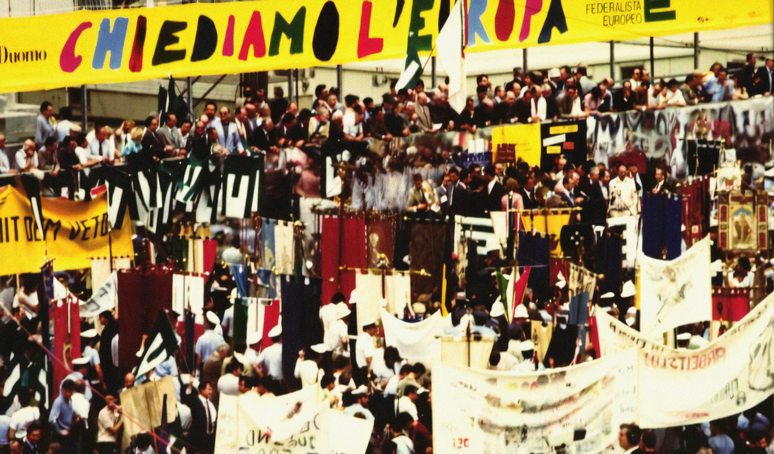
1979–1989: the new European Parliament
  The first European Parliament approves by a large majority the Spinelli Treaty (1984)
  The campaign for a more democratic Europe is slowed down by national governments

Slide 13
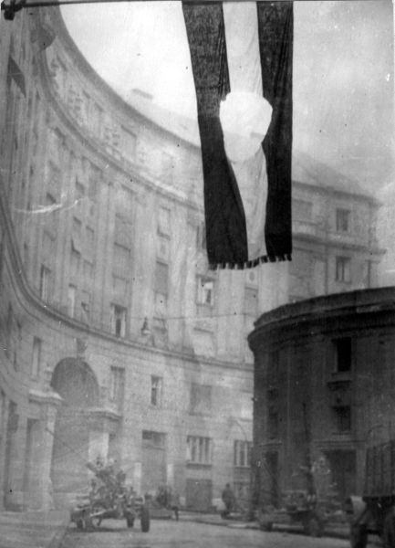
1989–2009: the Eastern enlargement and the European constitution project (1/3)
«Hungary has done more for freedom and justice than any other European people for twenty years. In Europe’s isolation today, we have only one way of being true to Hungary, and that is never to betray, among ourselves, or anywhere, what the Hungarian heroes died for and never to condone, even indirectly, what killed them.

Slide 14
1989–2009: the Eastern enlargement and the European constitution project (2/3)
The dissolution of the USSR bloc allow Eastern European countries to join the EU
  Even during the Cold War, in Berlin and elsewhere many people were ready to climb a dangerous wall to move to European Communities and join democratic countries
  After the USSR collapse, many countries join the EU – and other want to join even these days
  EU is faced with the question of deepening along with enlargement – both then and now

Slide 15
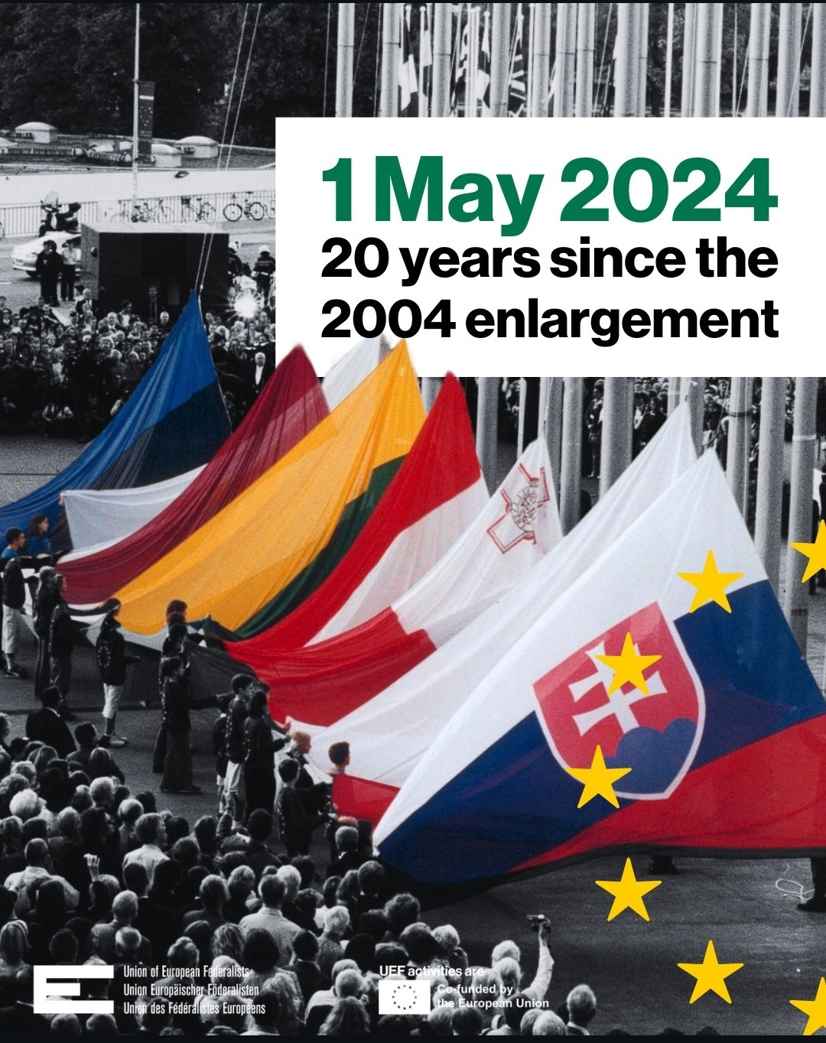
1989–2009: the Eastern enlargement and the European constitution project (3/3)
  1989: End of Berlin Wall
  1999: the euro is born
  2004: first Eastern enlargement
  2005: the project of a European Constitution is rejected by referenda in France and the Netherlands
  2009: Lisbon Treaty’s entry into force

Slide 16
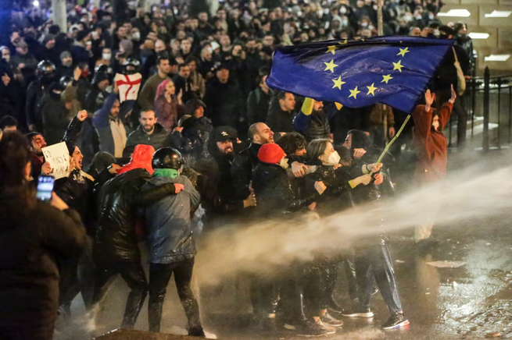
2009–today: a multi-faceted crisis (or the decline of Europe?)
  Since 2009, EU has coped with several crisis: sovereign debts, migration, covid pandemic, full-scale invasion of Ukraine etc
  If an «ever closer union» is not achieved, Europeans risk «compromising either freedom or environment or welfare»
  What next after 2024 European election?

Slide 17
Thank you!
unitaeuropea@mfe.it
Via Poloni 9, Verona
https://unitaeuropea.it/

